Slide 1
Data QC and best practices
Louise darroch, justin buck (BODC, NOC)

Slide 2
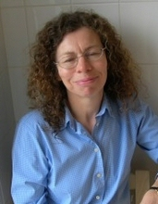
About me
Data manager at the British Oceanographic Data Centre (BODC) in the UK

Slide 3
Best practices Q & A
Q1. Is the data format capable of encoding a variety of QC protocols?
Yes!
….and no

Slide 4
QC protocols
Yes !
QC in Oceansites NetCDF
Global attributes
Coordinate variables
Data variables
Provenance
QC_indicator
Processing_level
Type, name, dimension, attributes
LATITUDE:QC_indicator = ;
LATITUDE:uncertainty = ;
LATITUDE:processing_level = ;
Type, name, dimension, attributes
TEMP_QC:long_name =; TEMP_QC:conventions =; TEMP_QC:coordinates =; TEMP_QC:flag_values =; TEMP_QC:flag_meanings =;
TEMP_uncertainty:long_name = ; TEMP_uncertainty:units =; TEMP_uncertainty:_FillValue = ; TEMP_uncertainty:comment =;
Describes overall dataset quality
Describes data channel quality
Describes data cycle quality
Either
Optional
Mandatory
Mandatory

Slide 5
QC protocols
Data cycle flags
Reference table 2

Slide 6
QC protocols
Processing level descriptors
Reference table 3

Slide 7
More info on QC indicators in data format
http://www.oceansites.org/documents/

Slide 8
QC protocols
No
Reference standard QC procedures (best practices)?

Slide 9
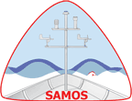
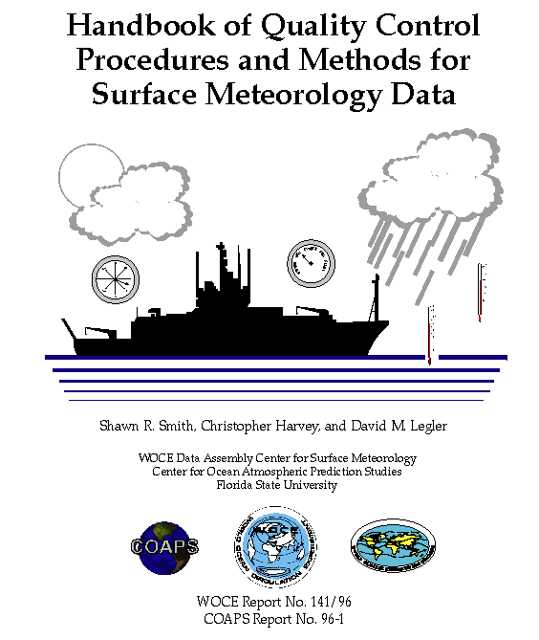
Example standard QC procedures
http://coaps.fsu.edu/woce/docs/qchbook/qchbook.htm
Flagging protocol
Time tests
Bound tests
Platform speed tests
Calculations (e.g. true wind)

Slide 10
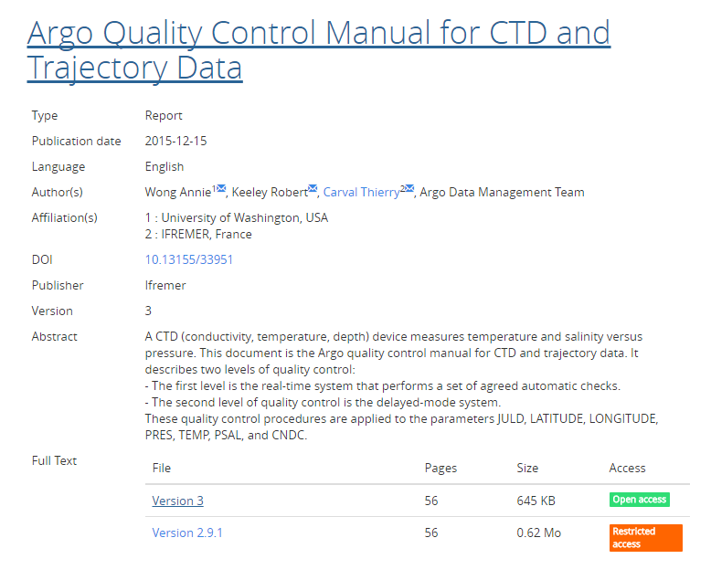
Example standard QC procedures
http://www.argodatamgt.org/Documentation
Flagging protocols
CTD pressure tests
Pressure and salinity adjustments
Protocols for near-real time and delayed-mode data

Slide 11
Example standard QC procedures
http://www.fixo3.eu/
QC procedures

Slide 12
Best practices Q & A
Q2. Is there data in OceanSITES, not currently QC’d at all and if so is this a DMT issue or Steering Team issue?

Slide 13
Best practices Q & A
Q2. Is there data in OceanSITES…?
Is there data not currently QC’d at all…?
Yes!
Err..
What | Number | %
Total | 31150
QC’d
Not QC’d

Slide 14
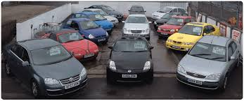
Best practices Q & A
Q2. …..and if so is this a DMT issue or Steering Team issue?
Steering team
or

Slide 15
Best practices Q & A
Q2A. Should the data format checker be checking all mandatory fields….?
….if so, is it?
Yes!
No
Available at http://www.coriolis.eu.org/Data-Products/Tools
Used by GDACs to check data
Should check any version of NetCDF sent
Should have documentation

Slide 16
Best practices Q & A
Q3. Perspective/challenges from AtlantOS

Slide 17
Optimising and Enhancing the Integrated Atlantic Ocean Observing Systems
Observing networks
GOSHIP
Standardised QC procedures
SOOP
CRP
Harmonise
Atlantic dataset
Fish + plankton
quality
ARGO
OceanSites
Glider
Surface drifter
Sea Floor mapping

Slide 18
Key observing variables
GCOS Essential Climate Variables
GOOS Essential Ocean Variables
Domain | GCOS Essential Climate Variables (ECV)
Atmospheric (over land, sea and ice) | Surface: | Air temperature, Wind speed and direction, Water vapour, Pressure, Precipitation, Surface radiation budget.
 | Upper-air: | Temperature, Wind speed and direction, Water vapour, Cloud properties, Earth radiation budget (including solar irradiance).
 | Composition: | Carbon dioxide, Methane, and other long-lived greenhouse gases[3], Ozone and Aerosol, supported by their precursors.
Oceanic | Surface: | Sea-surface temperature, Sea-surface salinity, Sea level, Sea state, Sea ice, Surface current, Ocean colour, Carbon dioxide partial pressure, Ocean acidity, Phytoplankton
 | Sub-surface: | Temperature, Salinity, Current, Nutrients, Carbon dioxide partial pressure, Ocean acidity, Oxygen, Tracers.
Terrestrial | Terrestrial: | River discharge, Water use, Groundwater, Lakes, Snow cover, Glaciers and ice caps, Ice sheets, Permafrost, Albedo, Land cover (including vegetation type), Fraction of absorbed photosynthetically active radiation (FAPAR), Leaf area index (LAI), Above-ground biomass, Soil carbon, Fire disturbance, Soil moisture.
Domain | GOOS Essential Oceanographic Variables (EOV)
Physics | Temperature (Surface, Interior), Salinity (Surface, Interior), Currents. (Surface, Interior), Sea Surface Height, Sea Ice, Sea State, Ocean Surface Vector Stress (new), Sensible and Latent Heat Fluxes (proposed)
Biogeochemistry | Oxygen, Inorganic Macro Nutrients, Carbonate System, Transient Tracers, Suspended Particles, Nitrous Oxide, Carbon Isotope (13C), Dissolved Organic Carbon
Biology | Under development

Slide 19
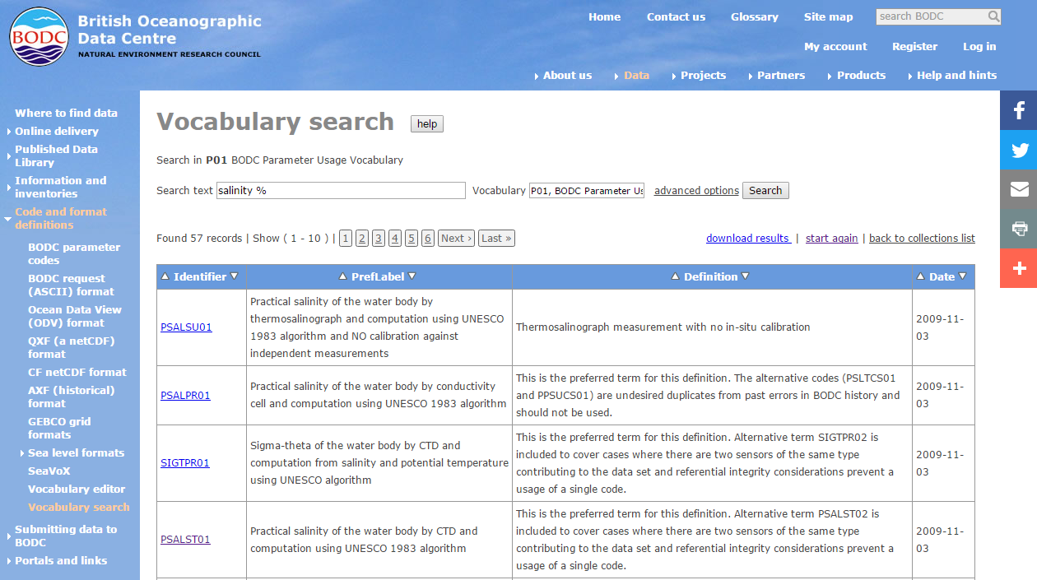
Data harmonisation and discovery
Controlled vocabularies
https://www.bodc.ac.uk/data/codes_and_formats/vocabulary_search/

Slide 20
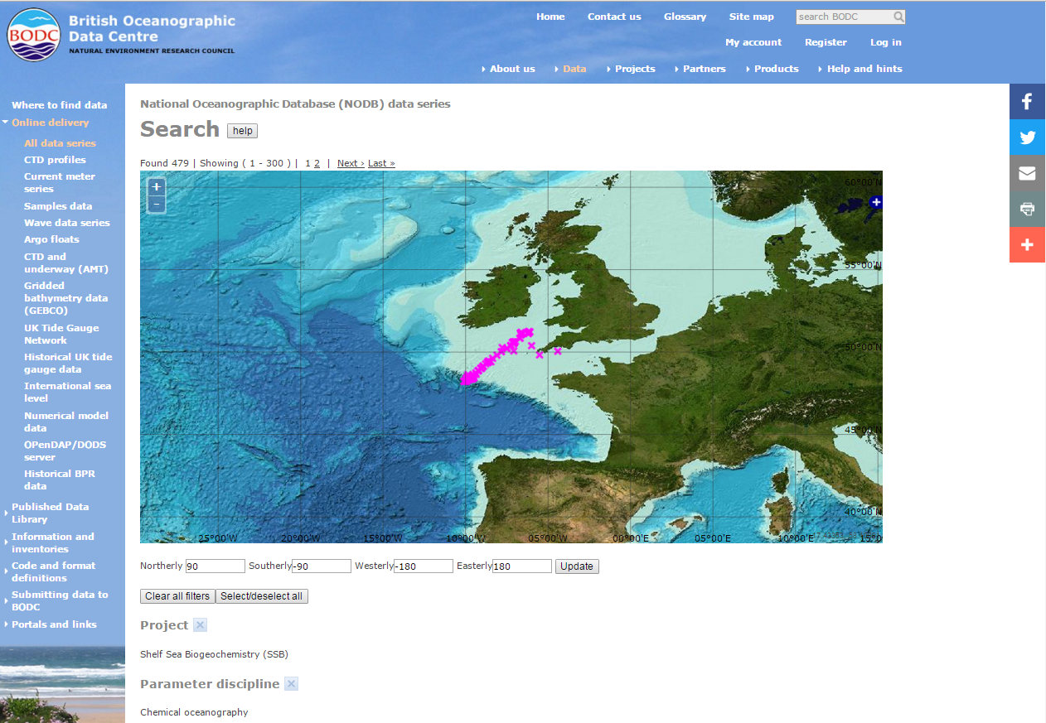
Data harmonisation and discovery
Controlled vocabularies
https://www.bodc.ac.uk/data/online_delivery/nodb/search/

Slide 21
Data harmonisation and discovery
Data vocabulary matrix

Slide 22
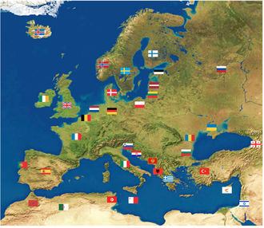
Data harmonisation and discovery
http://www.seadatanet.org/
SeaDataNet 2 EU project
44 data centres
Common vocabularies
Common format (CDI)

Slide 23
Data harmonisation and discovery
http://www.bodc.ac.uk
http://www.seadatanet.org/

Slide 24
Thank you

